Slide 1
Dormitories at
Wrocław University of Science and Technology

Slide 2
Remember to:
read Rules and Regulations of Dormitories at Wrocław University of Science and Technology
sign your individual contract
pay fee for a place in a dormitory till 15th of each month
clean your room and the common area you use
segregate and throw rubbish in designated areas located outside of the building
respect your surroundings and neighbors, especially in the quiet hours (23:00 – 7:00)
keep your thing inside your room (e.g shoes, clothes dryers, rubbish)

Slide 3
Remember:
smoking cigarettes inside the dormitory is forbidden
check your student email account (https://s.student.pwr.edu.pl/)
We would like to remind you that there is an obligation in Poland of Temporary residence registration.
To register your Temporary residence, please report to the City Hall with the temporary residence application form.
- This obligation applies to all students, not only the ones staying at Dormitories!

Slide 4
All students planning to stay in Student Dormitories are required to read and follow these rules.
Provisions regulating the functioning of WUST dormitories and guest rooms in connection with counteracting SARS-CoV-2 spread.
Procedure for accommodation in dormitories of Wrocław University of Science and Technology – PDF.
Operating procedure in case of suspected SARS-CoV-2 infection in wust dormitories – PDF.
(documents available at website https://prs.pwr.edu.pl/)

Slide 5
Remember to apply for dormitory for next academic year via Edukacja.CL system!
Detailed information will be published around May 2021 at website https://prs.pwr.edu.pl/

Slide 6
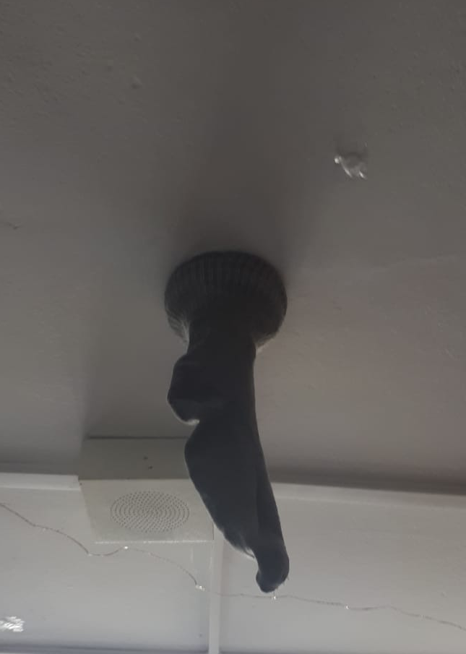
During your stay,please remember not to do this…

Slide 7
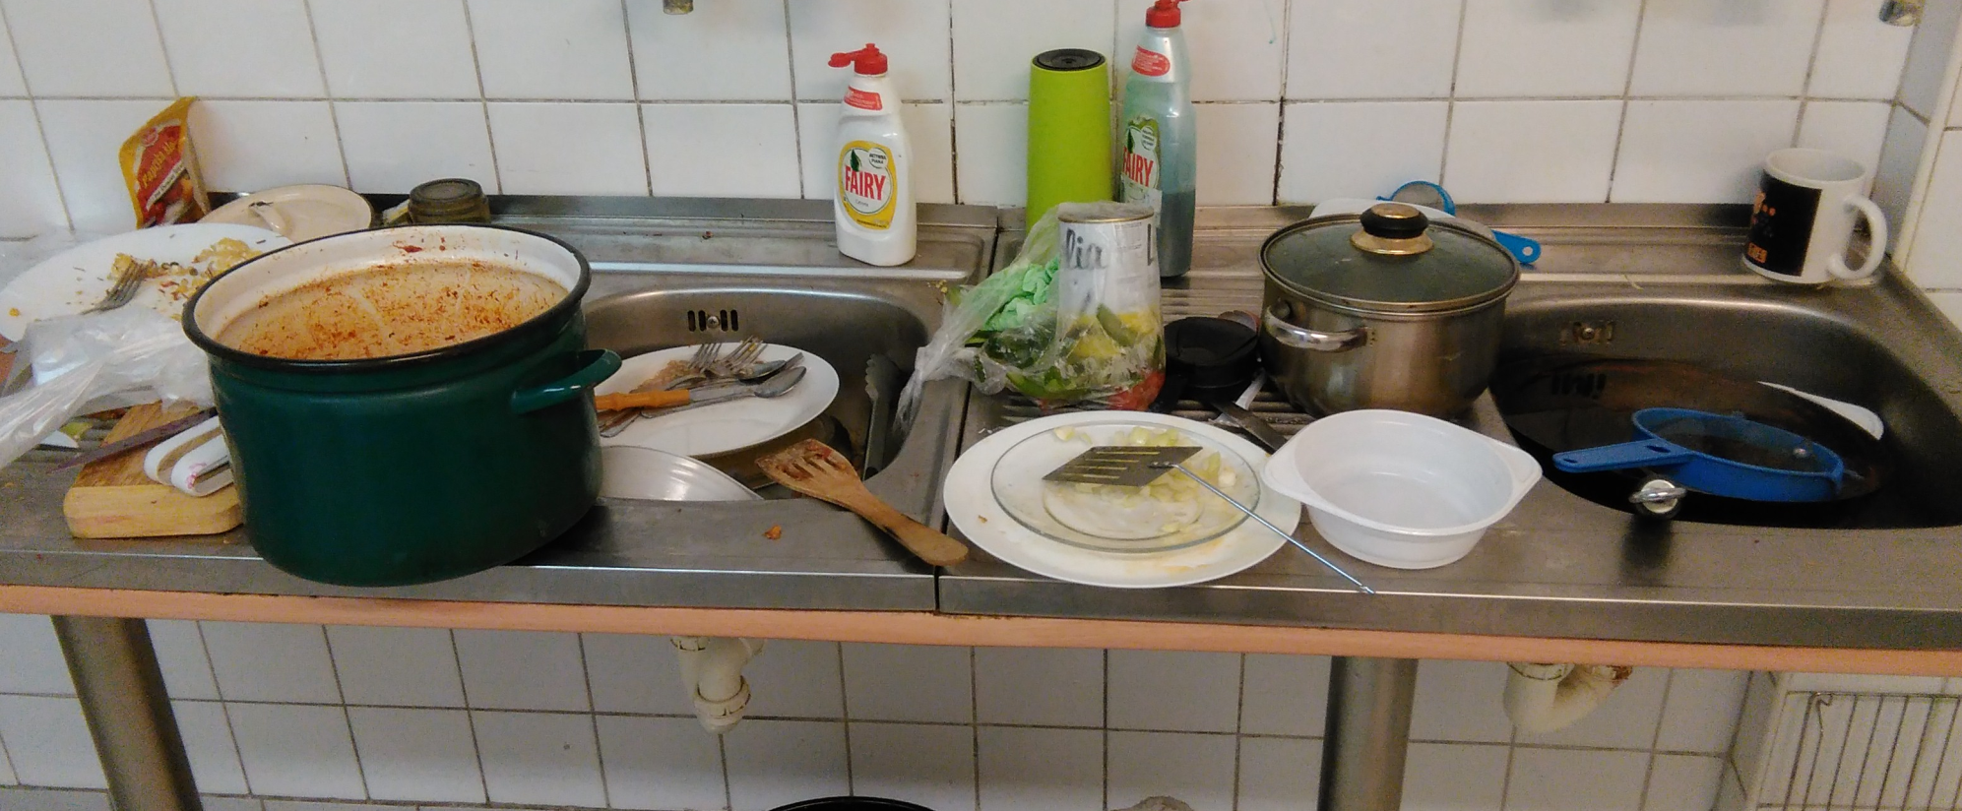
and this…

Slide 8
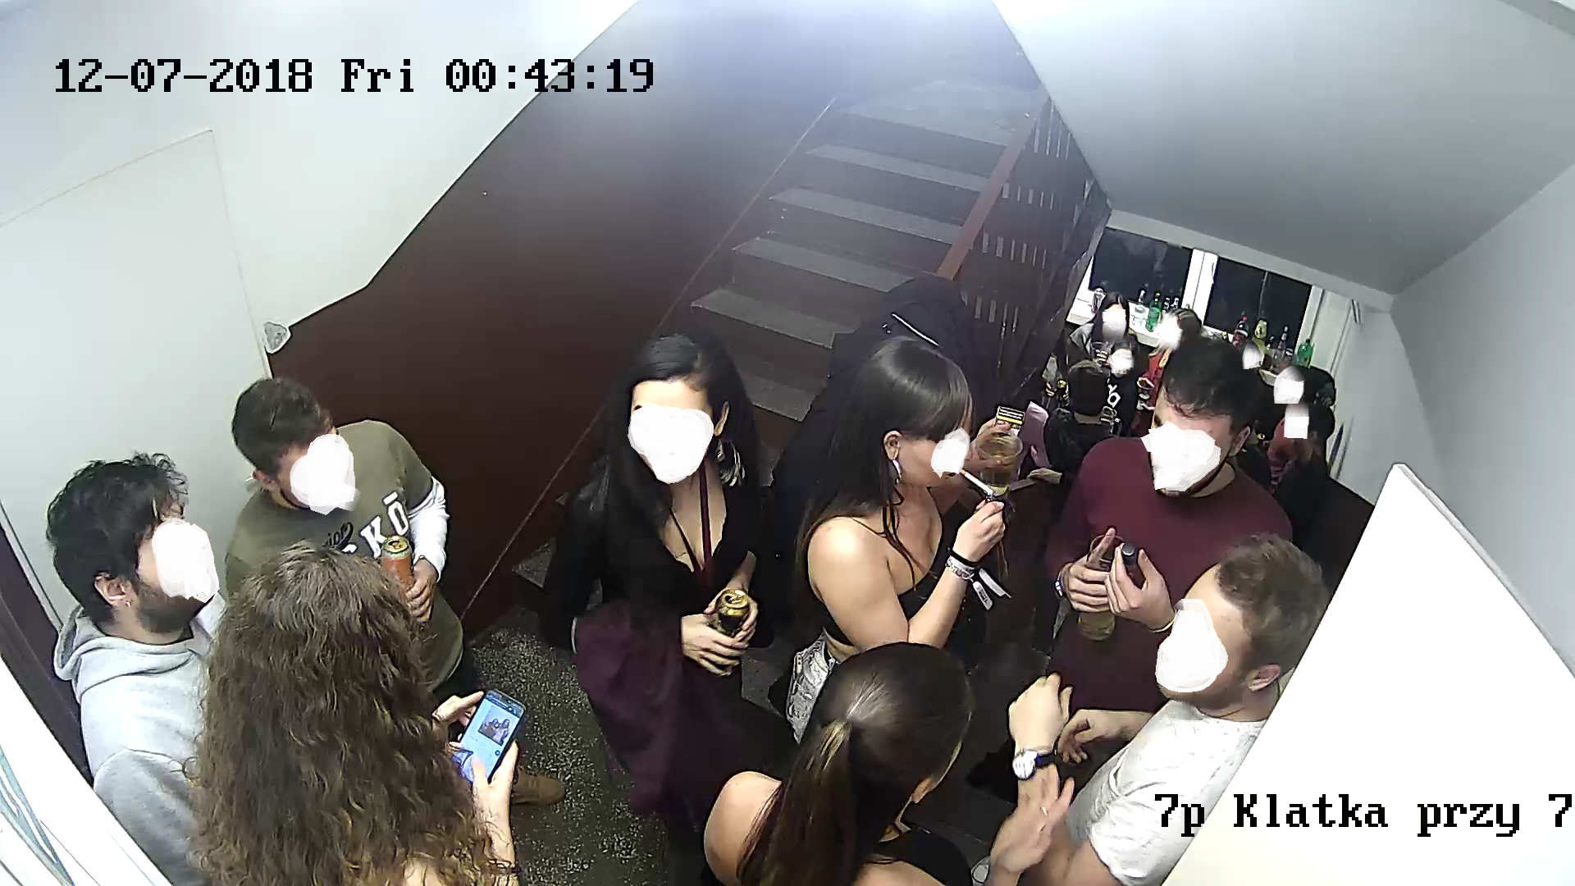
and this…

Slide 9
Thank you for your attention ☺

Slide 10
Important websites:
https://jsos.pwr.edu.pl/
https://edukacja.pwr.wroc.pl/
https://s.student.pwr.edu.pl/
https://prs.pwr.edu.pl/
http://drugidom.pwr.edu.pl/

